Slide 1
FORCES -COUPLE
Std 10
Part 2

Slide 2
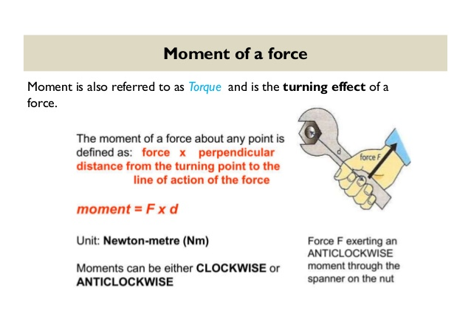
In the previous ppt we have studied about the moment of force , the clockwise and anti clockwise moments.
Gravitational units of moment of force
In C.G. S system the gravitational units of moment of force is ,
= 1 gf X 1cm
=980 dyne X 1 cm
= 980 dyne.cm
In M.K.S system
Unit of moment of force= 1 kgf X 1m
= 9.8 N X 1m
= 9.8 Nm
= 9.8 X 10⁷ dyne cm

Slide 3
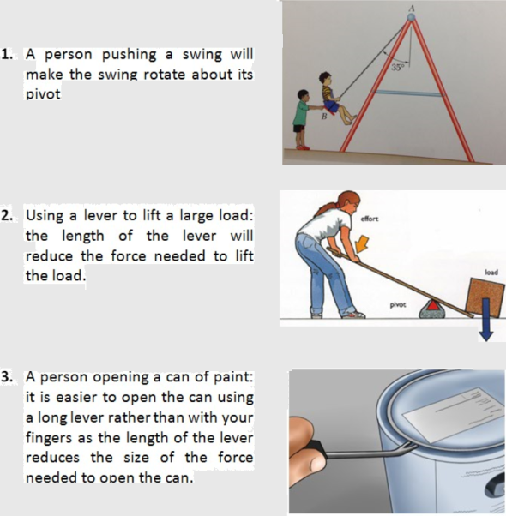
Some daily life examples of moment of force :

Slide 4
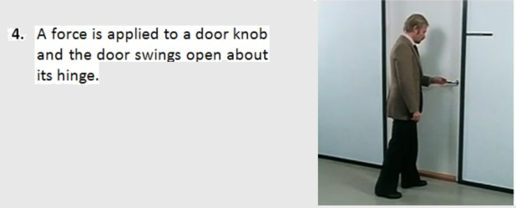
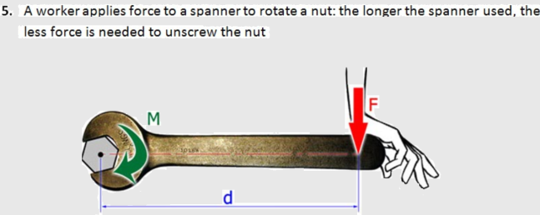

Slide 5
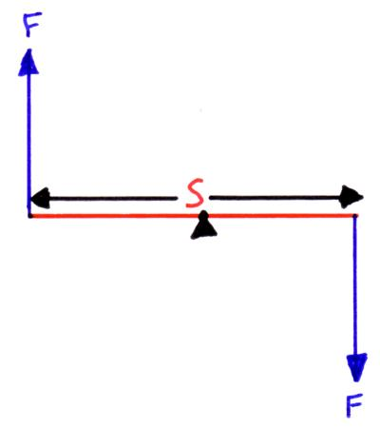
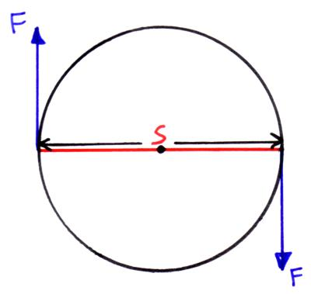
Couple
A couple is two equal forces which act in opposite directs on an object but not through the same point so they produce a turning effect.
The moment (or torque) of a couple is calculated by multiplying the size of one of the force (F) by the perpendicular distance between the two forces (s).
E.g. a steering wheel in a car;

Slide 6
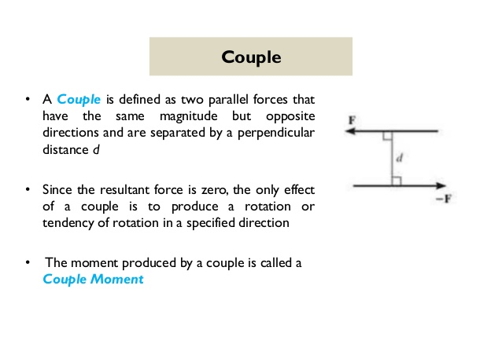
Another definition of couple can be,

Slide 7
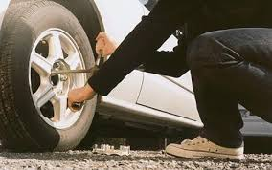
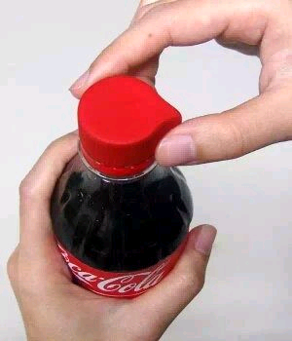
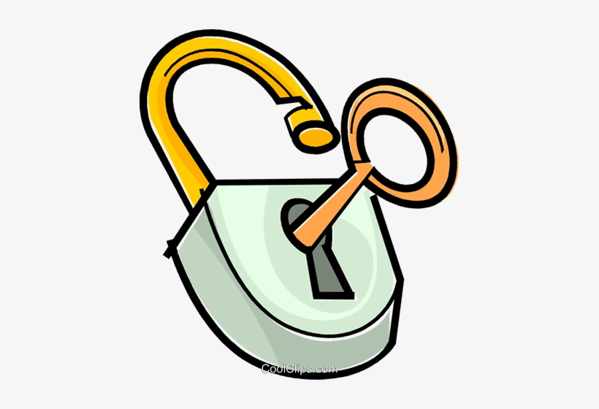
Some real like examples of couple :

Slide 8
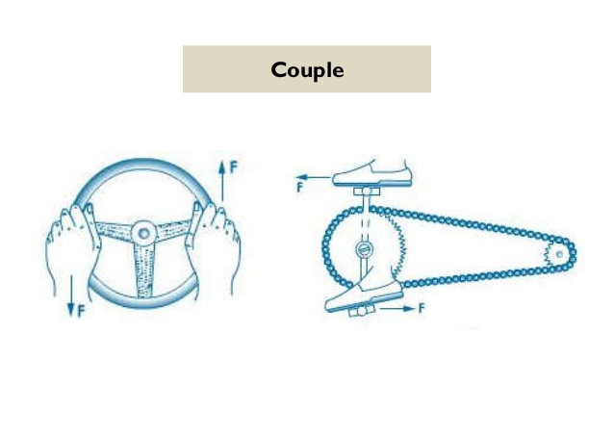
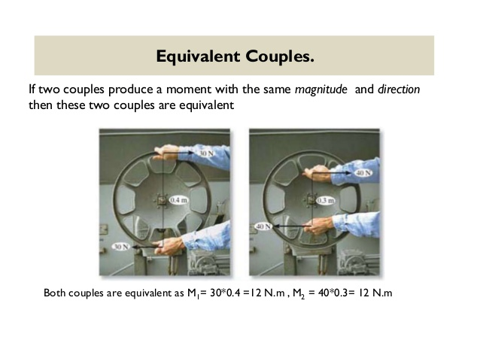
Some real life examples of a couple

Slide 9
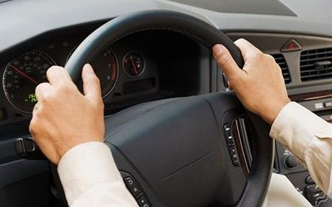
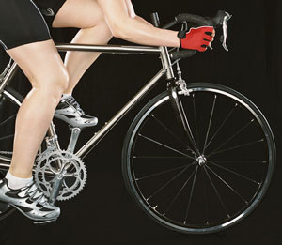
Example 1:
When driving your hands are opposite to each other on the steering wheel. The forces you apply with both hands when turning either left or right cause it to turn. Both hands are involved in turning the wheel; one hand pushes while the other pulls.
Example 2:
When a cyclist pedals, his or her feet are parallel. One foot pushes a petal forward while the other pushes the other pedal backward. These two forces cause the wheels on the bike to rotate.

Slide 10
Equilibrium Of Bodies
When a number of forces acting on a body produce no change in its state of rest or of linear or rotational motion, the body is said to be in equilibrium.
Kinds of equilibrium
1.Static equilibrium
2.Dynamic Equilibrium

Slide 11
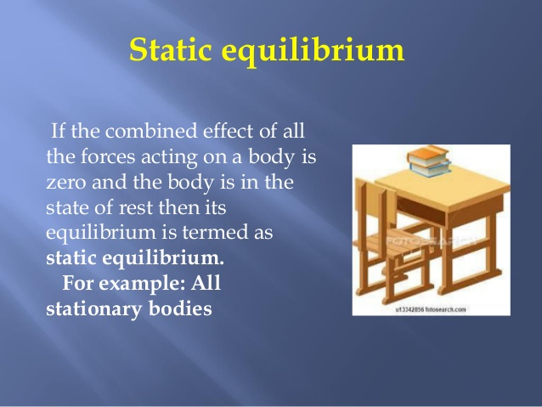

Slide 12
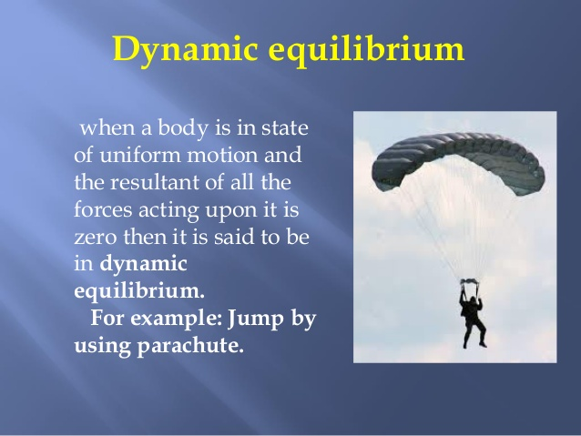

Slide 13
Conditions for equilibrium
The resultant of all the forces acting on the body should be zero.
The algebraic sum of moments of all the forces acting on the body about the point of rotation of zero.i.e sum of anticlockwise moments should be equal to the sum of clockwise moments about the same axis.

Slide 14
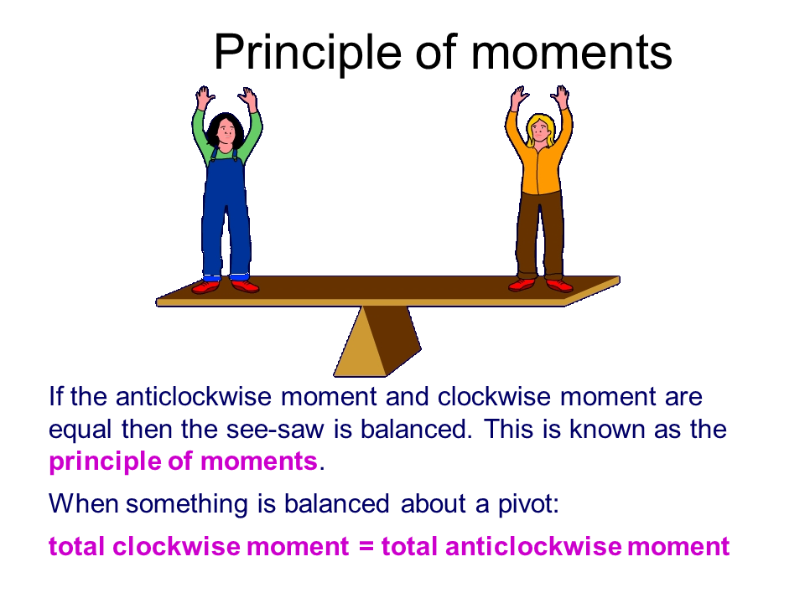
The principle of moments.
” When an object is in equilibrium the sum of the anticlockwise moments
about a turning point must be equal to the sum of the clockwise moments.”
sum of anticlockwise moments = sum clockwise moments

Slide 15
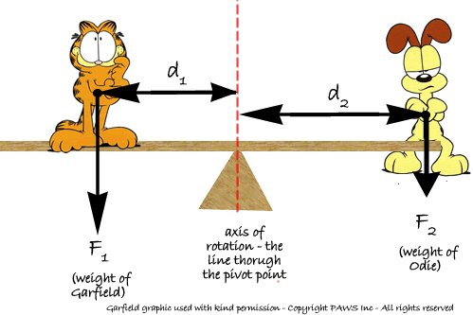
Garfield has considerably more weight than Odie - so for them to 'teeter-totter'
Odie has to sit a bigger distance away from the fulcrum.
To play 'see-saw' their moments have to be equal (according to the Princlple of Moments):
F₁d₁ = F₂d₂
As Odie has less weight (force) he needs more distance!

Slide 16
Principle of moments
Example calculation
Two girls are sitting on opposite sides of on a see-saw. One girl weighs 200 N and is 1.5 m from the pivot.
Where must her 150 N friend sit if the seesaw is to balance?
When the see-saw is balanced:
total clockwise moment = total anticlockwise moment
200 N x 1.5 m = 150 N x distance
200 x 1.5 = distance
150
distance of second girl = 2 m

Slide 17
IMPORTANT POINTS TO REMEMBER
A single force acting on a pivoted body, alone doesn’t cause the body to rotate.
The rotation is always produced by a pair of forces.
The pair of external force and the force of reaction about the pivot is zero,
so the force of reaction .
The pair of external force and the force of reaction is called a couple.
Thus two equal and opposite parallel forces not acting along the same line,
form a couple.
* To produce a rotation, a couple is always needed

Slide 18
Here are the list of various video links you can refer for the better
Understanding of the toipc.
https://www.youtube.com/watch?v=_LbeGj68atU
https://www.youtube.com/watch?v=SyOLIP_sIso
https://www.youtube.com/watch?v=ftIsrv3WAEg
https://www.youtube.com/watch?v=XFoMBC6g0M0

Slide 19
Instructions for students
To read - read from page number s 4 , 5, 6 and 7 , upto principle of moments.
Work to be done in the notebook
From the textbook – Exercise questions- Q3, 4, 5 and 6
Numericals
Practice problem 3 and 4, some parts are solved for your reference,
you need to do all the Practice Problems in the notebook ( the ones that I
have solved and the ones given as home work.)
For today, Practice Problem 3 and 4

